Slide 1
Jenkins
:- Pulkit Dhingra

Slide 2
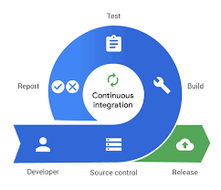
Continuous Integration
After a new commit to a source code repository, a build process of code is initiated automatically.
The autonomous building of code is one of the initial steps in the continuous integration setup.
The build process may include unit testing and source code analysis.
If the build fails for some reason, then the integration process is terminated and the previous successful build is rollback.

Slide 3
Some confusing terms
Continuous Integration
The practice of merging development work with the main branch constantly.
Continuous Deployment
The deployment or release of code to production as soon as it is ready
Continuous Delivery
Continuous delivery of code to an environment once the code is ready to ship. This could be staging or production. The idea is the product is delivered to a user base, which can be QAs or customers for review and inspection.

Slide 4

Jenkins
It is a continuous integration and build server
It is written in java thus requiring a JRE to run
Manual,automatic or periodic builds are possible for software deployment

Slide 5
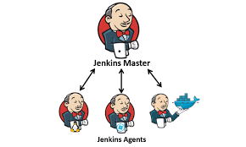
Distributed Architecture of Jenkins
The master node is responsible for the job scheduling and dispatch builds to the slaves for actual job execution.
The Jenkins agents execute the jobs assigned by the master.

Slide 6
Demo
Install jenkins
Install plugin jenkins overview
Various pipeline possible
Build java code pipeline
Build dotnet code pipeline
Build python pipeline

